Slide 1







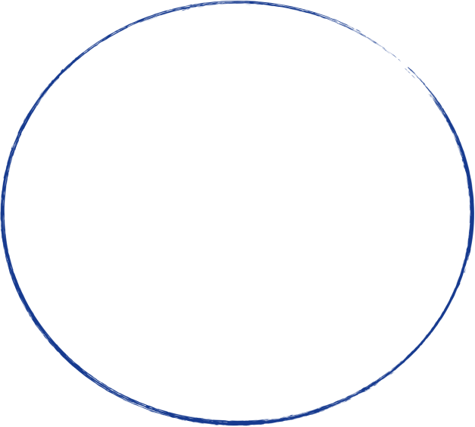











The Underlying Logic of
Optimizing Promotions
Chuwen Feng, Changjiang Song, Chiao-Chien Chen,
Zijing Bai, Hongyi Hu
.

Slide 2







01. Introductions
02. Analysis
Content.
03. Conclusions
Created and designed by Plura.

Slide 3





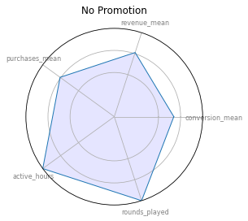
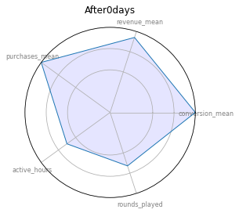


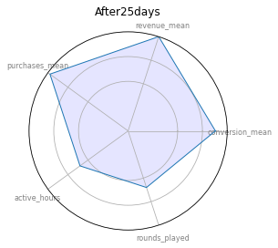
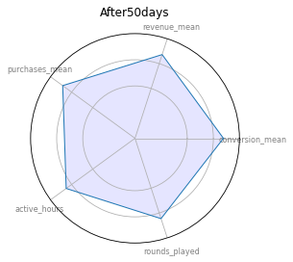
Visualization through radar
graphs

Slide 4
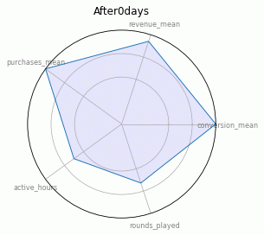






We can see these changes more clear through dynamic pictures

Slide 5
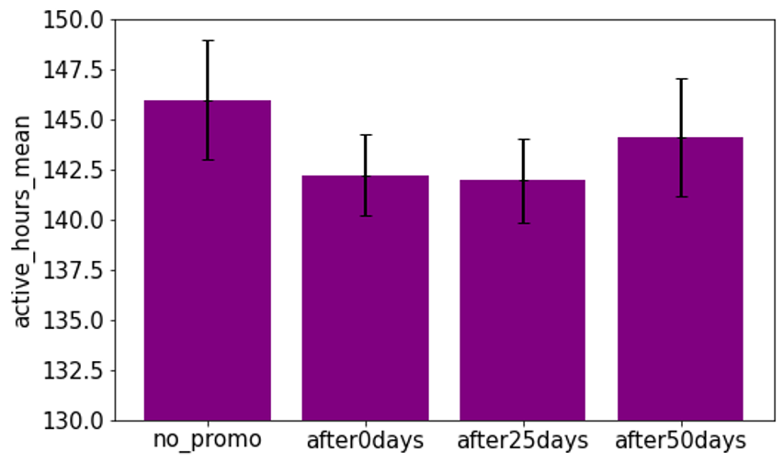
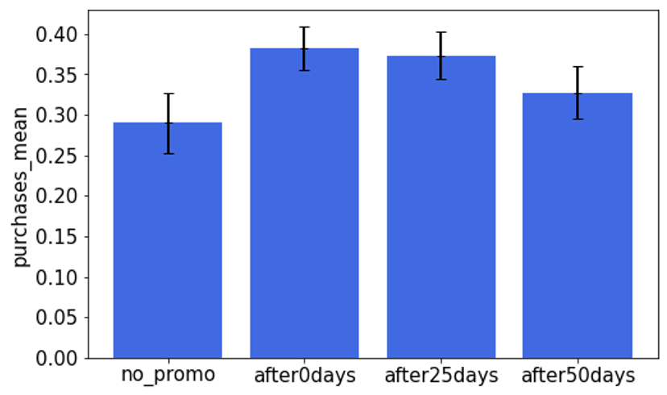
active_hours
It shows that active hours in control group is higher than that in the treatment group
“TRADE OFF”？
Between
Playtime &
Purchases
purchases
It shows that purchases in control group is lower than that in the treatment group

Slide 6
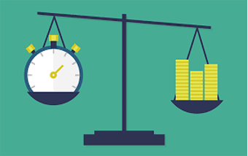
Definition of “TRADE OFF”:
A balance between two opposing things, that you are willing to accept in order to achieve something.
“TRADE OFF”？
Between Playtime &
Purchases
We found that the current promotion has an impact on the two features of active_hours and purchases.
It seems like to be a relationship similar to trade off between them, but in fact they are not really trade offs. t

Slide 7
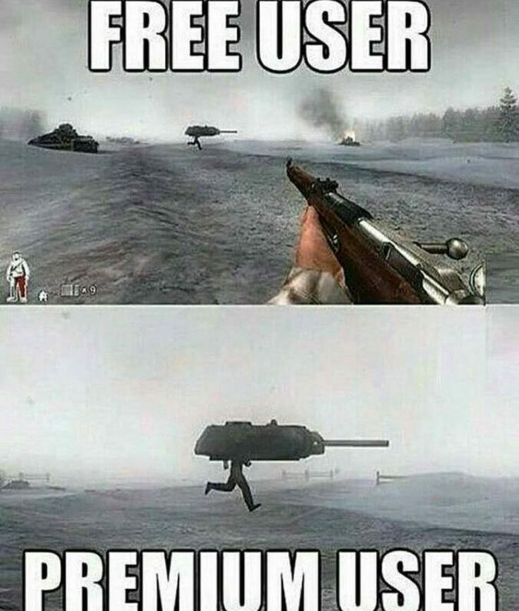
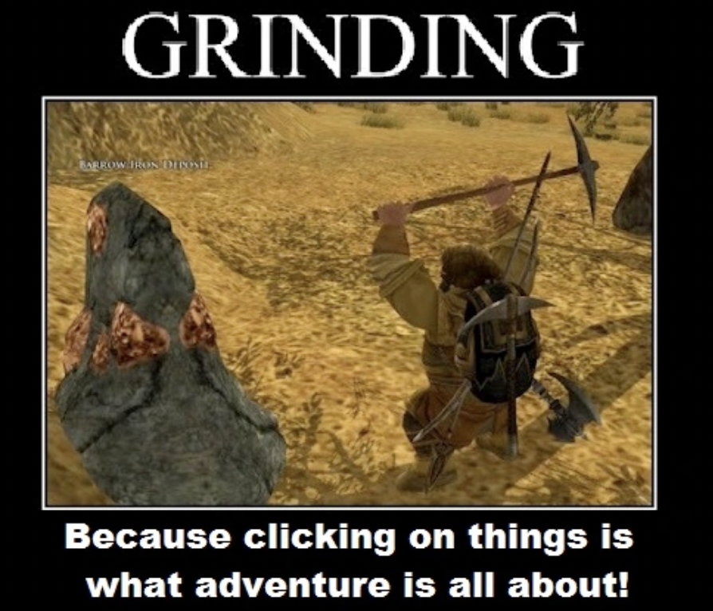
"Pay to Win" Metrics
"Farm to Win" Metrics
At the stage where we already know...​
•The promotion is effective​ in general
•The “tradeoff like” relationship between "farm to win" and "pay to win" exists​
The next topic is to identify what promotion is considered better.
Created and designed by Plura.

Slide 8
Promotion Design: Phase 1
In terms of “pay-to-win” metrics, promotions work for sure, but how?
What did promotion do?
•Conversion rate increased: Potential users converted (0 → 1)
•Purchase and revenue increased: stimulated paying users to pay more (1 → more)
Simple Conclusion/ Assumption:
The existence of promotion makes people want to pay; people are more impulsive in accepting promotion offers for reasons we need to identify
Underlying Logic of
How Promotions
Work
Notes:
In the era where promotions are everywhere, none of us need to emphasize that promotions work. What really matters is the underlying logic of how promotions stimulate users, so that we could optimize promotions in details.
User Behavioral Change by approving promotions:
•Conversion rate increased: Potential users converted (0 → 1)
•Purchase and revenue increased: stimulated paying users to pay more (1 → more)
Simple Conclusion/ Assumption: The existence of promotion makes people want to pay; people are more impulsive in accepting promotion offers for reasons we need to identify

Slide 9
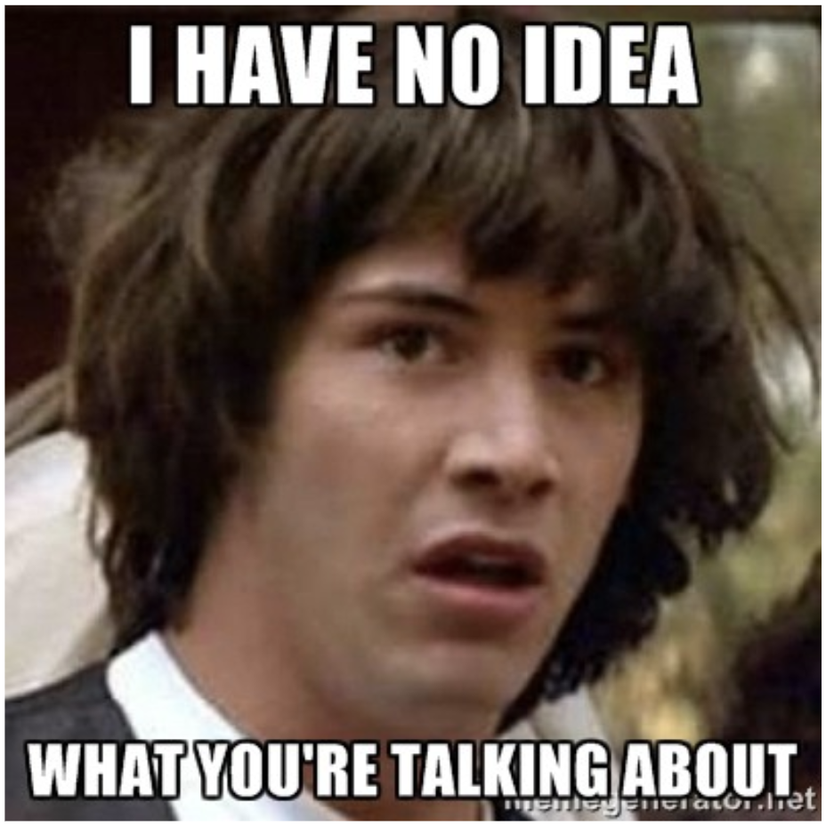
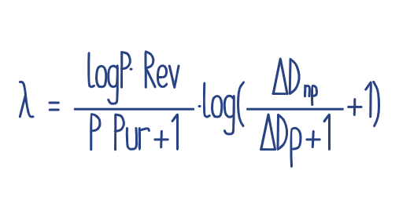

Promotion Design: Phase 1
Basically, there are only two major dimensions when measuring users’ impulsiveness stimulated by promotions
Term 1: How “hard” a user reacted to promotions
Term 2: How “fast” a user reacted to promotions
Term 1:
The amount of revenue generated for one purchase made under promotions.
Term 2:
Number of days difference between the first purchase made when having or not having promotions

Slide 10
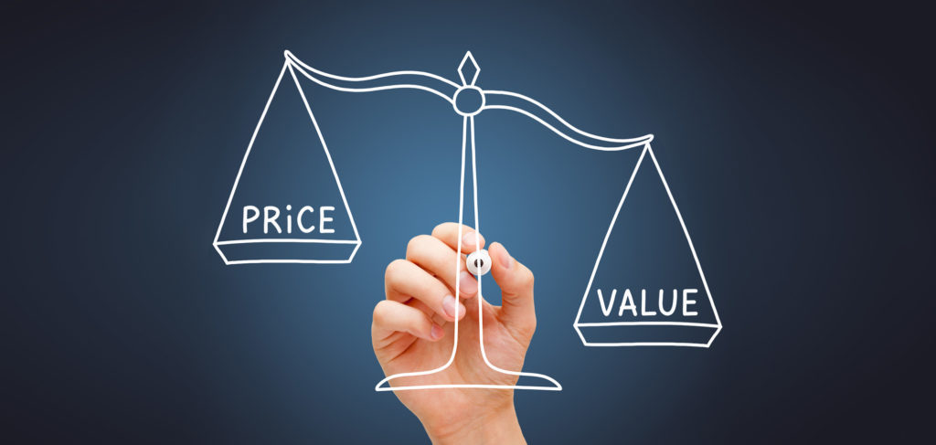
Promotion Design: Phase 1
The question:
The price of the best promotion
Even though pricing is based on value created, value is not the value that sellers think it is supposed to be; it is the value that customers think it is supposed to be.
Whereas, Customers think differently.
Notes:
The question:
Pricing is always a controversial topic, designing an appropriate price is critical for your customers to actually take the offer.
Even though pricing is based on value created, value is not the value that sellers think it is supposed to be; it is the value that customers think it is supposed to be.
Whereas, Customers think differently.

Slide 11


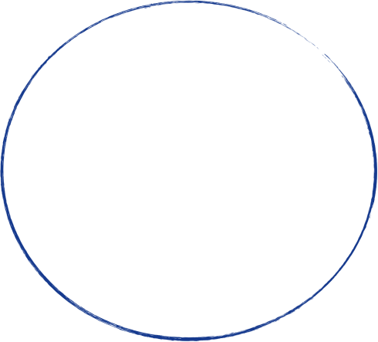
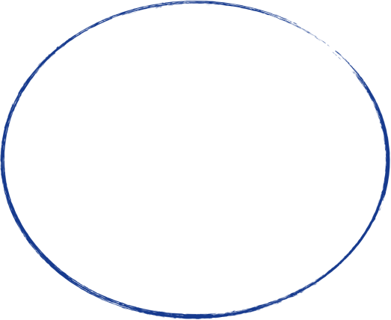




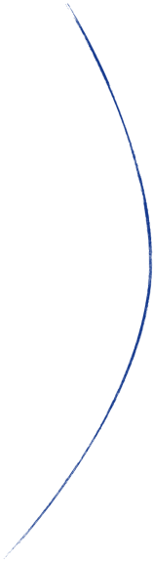

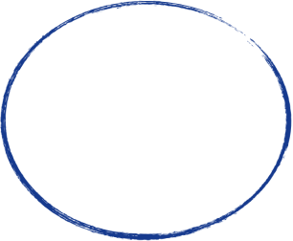



Promotion Design: Phase 1
The solution:
To do a segmentation on unbiased group, finding the characteristics among different customers; Then design promotion plans specifically for each segment.
The unbiased group, so called the group of people without treatment effect. In our case, we have two options.
Users in control group ❌
Everyone bcefore finishing chapter one of the game ✅

Slide 12
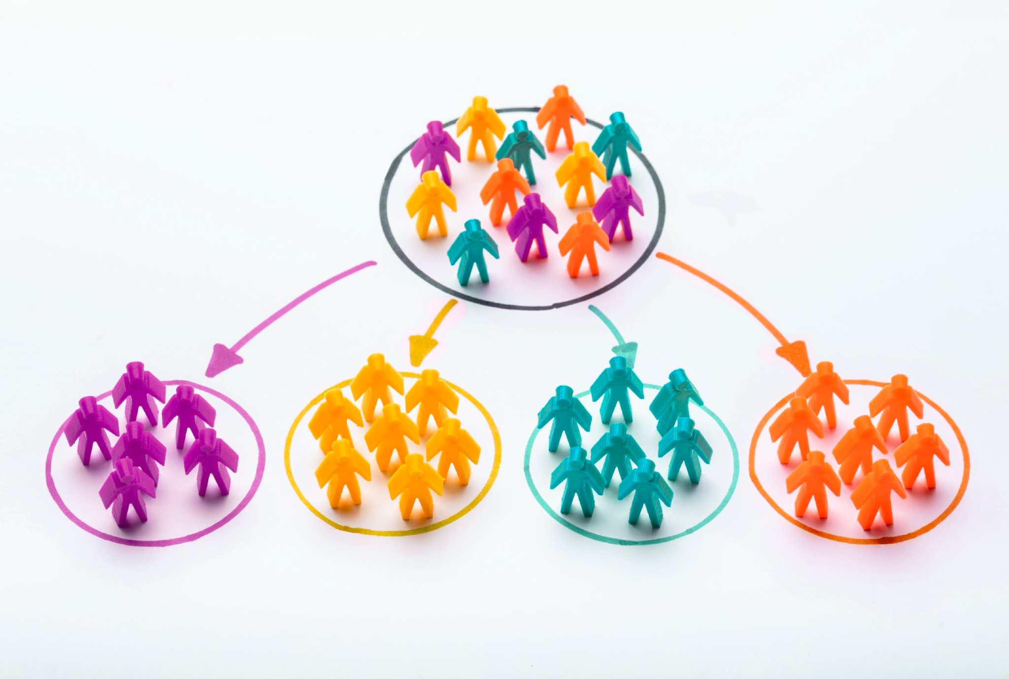
Promotion Design: Phase 1
Feature Selected:
c
revenue_ch1
cash_spent_ch1
dpi
mobile resource
Model Used:
K-Prototype
Sample Size:
10,000 (minmum required: 342)
Created and designed by Plura.
Notes:
Feature Selected:
activity_hours_ch1 (Amount of time a user is willing to spend in game before ch1)
revenue_ch1 (Amount of revenue a user could bring in game before ch1)
cash_spent_ch1 (Engagement of in-game currency spending before ch1)
dpi (Representing the display quality of devices, often related to in game experience)
mobile resource (The channel a user is attracted from)
Model Used:
K-Prototype

Slide 13


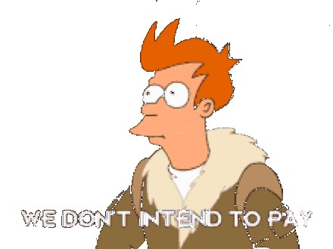
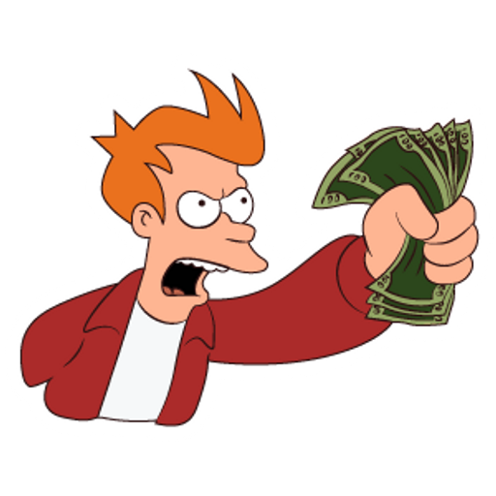
Active Users
Inactive Users
Segmentation Results
Two Categories
Four Segments
Then, we join “Impulsiveness” back to the sample dataset to see how impulsive each segment is…
Type 1 Users: “Believers ”
“We play, we pay”
Very few users
From paid channel
Impulsiveness Term1: Extremely High
Impulsiveness Term2: Extremely High
Type 3 User: "Apathies"
“Sorry but we are not into this”
From paid channel
Typical Inactive users
Impulsiveness Term1: Low
Impulsiveness Term2: Low
Type 2 Users: “Observers”
“Let us see and try what game you got”
Promotion could be still very effective
From paid channel
So-called, potential users
Impulsiveness Term1: Slightly Higher
Impulsiveness Term2: Slightly Higher
Type 4 User: "Neutral"
“The Game worth trying, but we stay calm”
Very close to type 3 users, but higher active hours
From paid channel
Impulsiveness Term1: Extremely Low
Impulsiveness Term2: Extremely Low

Slide 14
Segmentation Results in detail
 | active_hours_ ch1 | revenue_ ch1 | cash_spent_ ch1 | dpi | mobile_ source | Impulsiveness | Impulsiveness_T1 | Impulsiveness_T2 | Count
Sample Mean/Mode | 7.3993 | 0.0866 | 58.9909 | 320 | Paid | 0.0287 | 0.0238 | 0.0416 | 10000
“Believers” | 12.0594 | 7.0970 | 188.554 | 320 | Paid | 0.0611 | 0.1725 | 0.0730 | 101
“Observers” | 7.7735 | 0.0394 | 98.8784 | 320 | Paid | 0.0379 | 0.0325 | 0.0539 | 3784
“Apathies” | 6.9029 | 0 | 54.3928 | 320 | Paid | 0.0233 | 0.0190 | 0.0342 | 2543
“Netural” | 7.2245 | 0 | 16.346 | 320 | Organic | 0.0219 | 0.0138 | 0.0330 | 3572

Slide 15
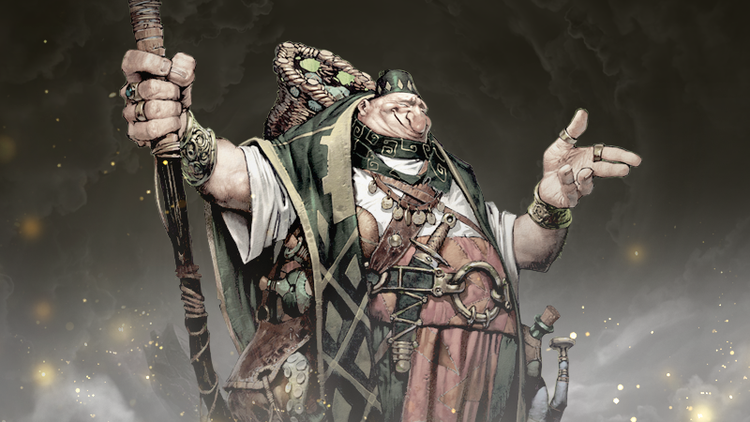
Key Takeaways
Feasibility of Differentating promotion plans
With supporting references, promotion plans can then be designed trustfully.
Business Ethic
Price discrimination? No No No…
It is secret/special/kind/useful/unique promotion packages we picked for customers.
Paid Mobile Sources Are Worth Having
Even the most inactive users from the paid channels are still more impulsive than those from organic.
Here comes with our phase 1 outcome:
“The Secret Shop”
-Emphasize the sense of mystery, uniqueness, and exclusive
Notes:
Feasibility of Differentating promotion plans
By understanding impulsiveness composed of two terms and characteristics of each segment, It is then possible to conclude what promotions best fit each user type.
Business Ethic
The strategy of applying different promotions to different people could be dangerous since it is basically price discrimination, a wordplay or decoration is needed to cover the purpose of doing this.
Paid Mobile Sources Are Worth Having
Even the most inactive users from the paid channels are still more impulsive than those from organic.

Slide 16
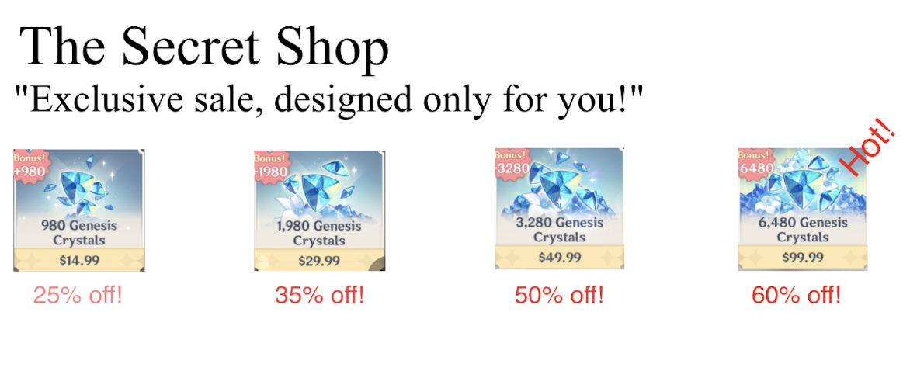
Promotion Design: Phase 1.The Final Outcome
Example: The Secret Shop for “Belivers”
Prototype User Interface along with its key elements:
Title: This is “The Secret Shop.”
Tagline: Stimulate users by words
Price-off tag: Emphasize those we think is more acceptable for users
Countdown clock: Limited time only!
Screenshots are from “Genshin Impact,” only for reference.
Notes:
Prototype User Interface along with its key elements:
Title: “The Secret Shop.”
Tagline: wordplay, designed based on early revealed characteristics of each segment.
Price-off tag: highlights the one with the most appropriate face value to each segment and marks it with “hot” or with other keywords.
Countdown clock: limited the time user can purchase; the time given is distinct according to the second term of impulsiveness within each segment.

Slide 17
Key Elements Details of “The Secret Shop” for Each Segment
 | Title | Tagline | Price-off tag | Countdown clock
“Believers” | “The Secret Shop” | “Exclusive sale, designed only for you!” | 59.99$ 99.99$ | 48 Hours
“Observers” | “The Secret Shop” | “Having a bit of trouble? Your special delivery just arrived!” | 29.99$ 59.99$ | 78 Hours
“Apathies” | “The Secret Shop” | “The only package you need!” | 4.99$ 9.99$ | 168 Hours
“Netural” | “The Secret Shop” | “The only package you need!” | 2.99$ 4.99$ | 120 Hours

Slide 18

The Last Topic in Phase 1:
What Is The Best Timing to Initalize Promotions
At this point, we have all four promotion plans ready to be implemented, but when?
Taking average impulsiveness as a threshold, we ask, what percentage of users in each treatment group are more impulsive than the smaple average.
T0: 4.25% T25: 3.09% T50: 2.46%
Among all users in the T0 group, 4.25 percent of them will show impulsiveness higher than the sample average.
Conclusion: “The Secret Shop” will be implemented right after users finish chapter one.

Slide 19

Promotion Design: Phase 2
In terms of “farm-to-win” metrics, is promotions the reason people play less?
Dive Even Deeper
Simple Conclusion/ Assumption:
If promotion makes user play less, it has to be something they got from the promotion, which is effecting their users’ behavior.
Notes:
In the era where promotions are everywhere, none of us need to emphasize that promotions work. What really matters is the underlying logic of how promotions stimulate users, so that we could optimize promotions in details.
User Behavioral Change by approving promotions:
•Conversion rate increased: Potential users converted (0 → 1)
•Purchase and revenue increased: stimulated paying users to pay more (1 → more)
Simple Conclusion/ Assumption: The existence of promotion makes people want to pay; people are more impulsive in accepting promotion offers for reasons we need to identify

Slide 20
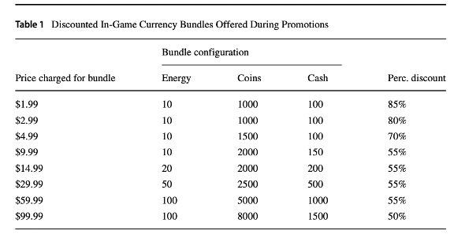
Promotion Design: Phase 2
What could users get from promotion bundles?
Energy
Coins
Cash

Slide 21
Promotion Design: Phase 2
The change in percent of each in-game currency could be written as the ratio between the amount currency spent per round within 180 days divided by the amount currency spent per round before chapter 1.
In-game Currency Usage by Treatment Groupscg
 | Coins | Cash | Energy
No_promo | 216.81% | 23.35% | N/A
T0 | 230.56% | 23.74% | N/A
T25 | 216.59% | 23.86% | N/A
T50 | 212.02% | 23.29% | N/A
The Study of Three in-game Currency usage
The amount of coins need in the late game is doubled, whereas the demand of cash is quartered, comparing to the demand before chapter 1.

Slide 22
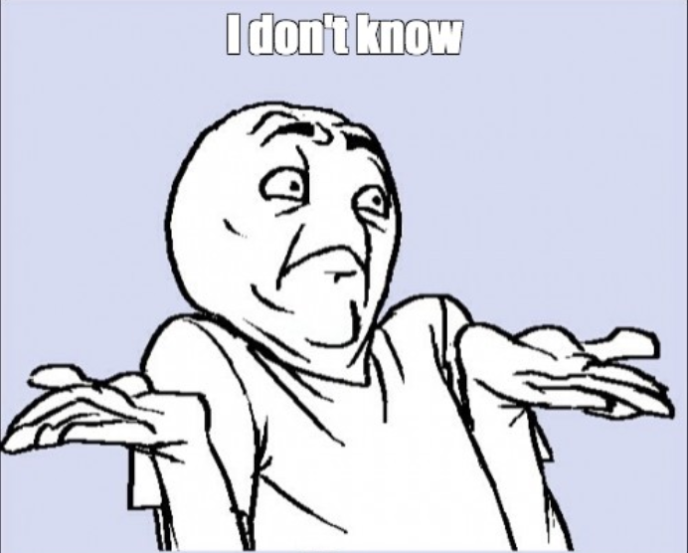
Promotion Design: Phase 2
The question we wanted to answer: why promotions make people play less?
The answer we got after studying In-game currency usage by treatment groups:
Not All The Assumptions can be Tested Out
Notes:
The demand change for all the in-game currencies tells nothing about why promotions make people play less since all four groups performed closly; Or the one could answer this question is "energy" which we have no information about.

Slide 23
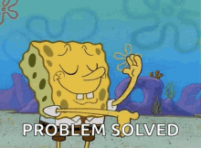
Promotion Design: Phase 2
Nevertheless…
The fact that all users need to spend more cash in chapter 1 and more coins afterward inspired us to think of having a certain type of promotion with the following features:
The focused point of rewards varies across time.
Flexible combination of rewards design
And in case this promotion could also have features like:
Not very expensive
Acceptable for inactive segments
Contributive to customer retention
The chance we increase users’ activity hours would be raised.

Slide 24
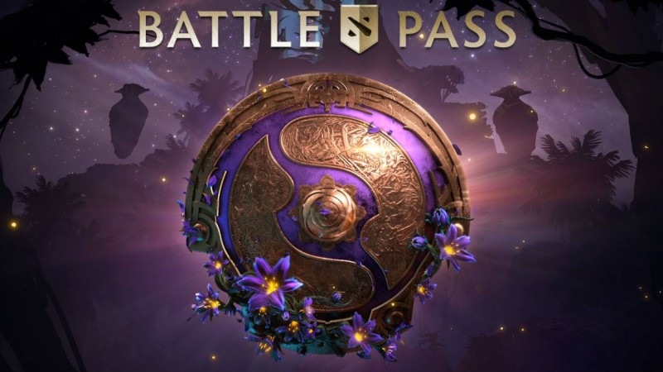
Promotion Design: Phase 2
So-Called, The Battle Pass
Battle passes were first introduced by Valve Corporation in 2013 for the popular massive online battle arena (MOBA) Dota2 (2013) as the ‘compendium’, an opt-in paid progression system that would partially raise money for Dota2’s yearly international tournament.

Slide 25
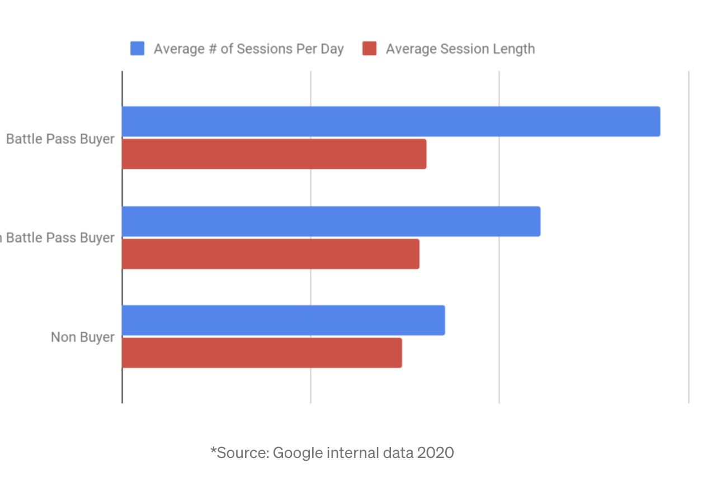
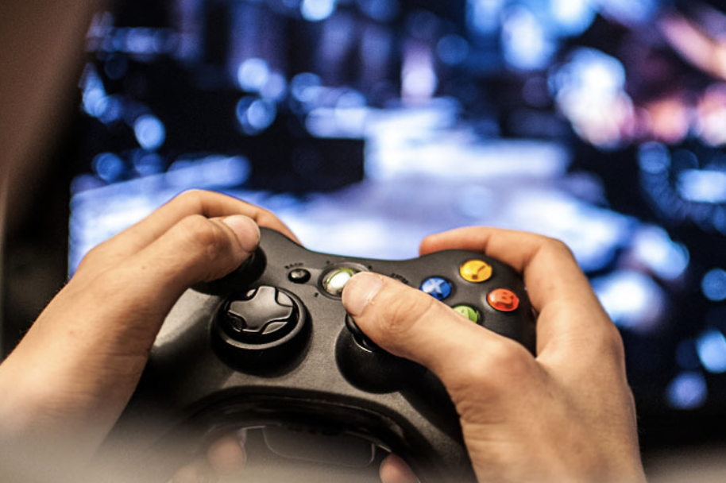
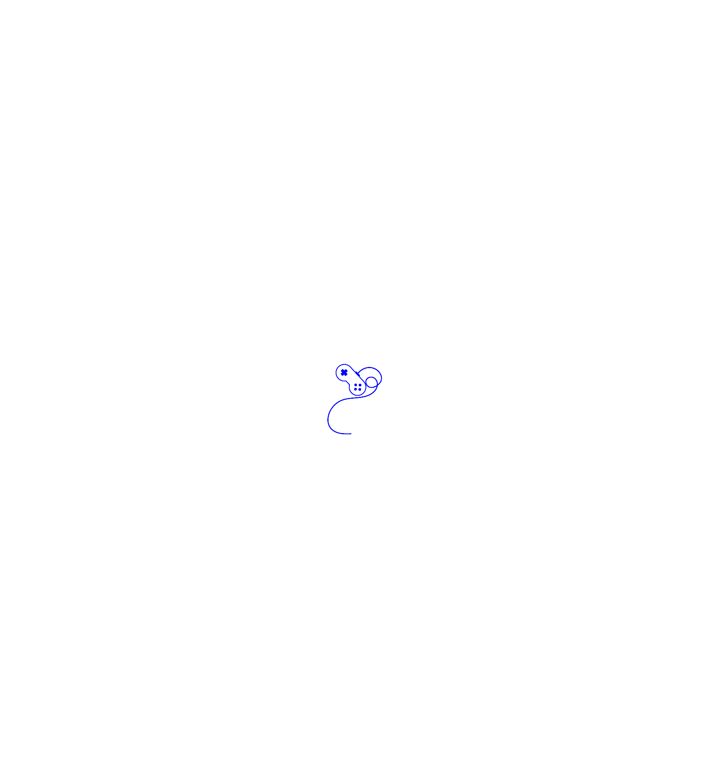
Battle Passes
Yves Klein
Increase the time users have to play games
https://medium.com/googleplaydev/how-battle-passes-can-boost-engagement-and-monetization-in-your-game-d296dee6ddf8

Slide 26
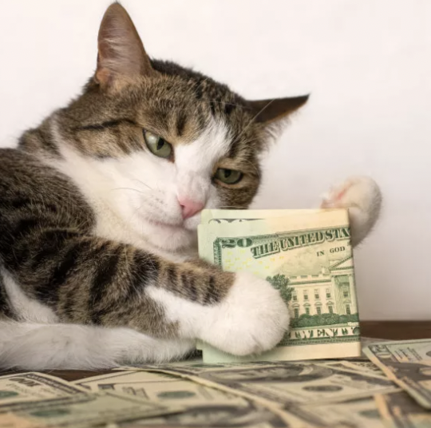
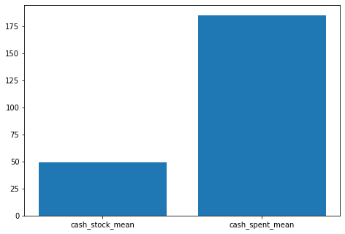
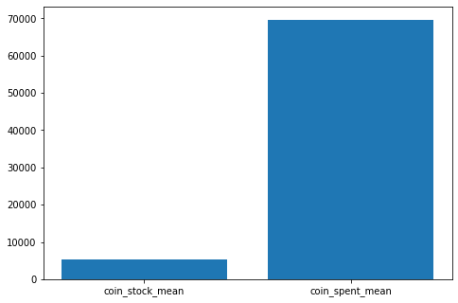
Battle Passes
Coins are more relied by the user duing the game time
Cash is more like a tool used to satisfy the user's vanity

Slide 27
Accumulated reward
Instant reward
Choice 1
FREE
No instant reward
Two versions of BP can let users have a choice that which version better fits them.
Since we noticed that users has the higher demand of coins. Coins will be gained as the reward after the maximum lever.
Maximum level: 100
Free version total reward:
10 energy, 400 coins, and 40 cash.
No reward after level 100
Premium total reward:
40 energy, 2000 coins, and 200 cash
After lever 100, users can still get coins as the reward if they keep doing the mission and gaining the Exp.
Choice 2
Price: $9.99
10 energy, and 30 cash
Period: 2 weeks
Choice 3
Price: $19.99
Advance BP 20 level
20 energy, and 30 cash
Special badges
Period: around 10-11 days

Slide 28

Thank You.

